Slide 1
Solving recurrences

Slide 2
Recurrences
A recurrence is an equation or inequality that describes a function in terms of itself by using smaller inputs
The expression:
is a recurrence.

Slide 3
Solving Recurrences
Examples:
T(n) = 2 T(n/2) + Θ(n)
T(n) = Θ(n lg n)
T(n) = 2T(n/2) + n
T(n) = Θ(n lg n)
T(n) = 2(T(n/2)+ 17) + n
T(n) = Θ(n lg n)
Three methods for solving recurrences
Substitution method
Iteration method (Recurrence Trees)
Master method

Slide 4
Iteration Method
Iteration method:
Expand the recurrence k times
Work some algebra to express as a summation
Evaluate the summation
We use the recurrence tree for simplicity

Slide 5
Example 1

Slide 6
Recursion tree
Solve T(n) = T(n-1) + c, where c > 0 is constant.

Slide 7
Recursion tree
Solve T(n) = T(n-1) + c, where c > 0 is constant.
T(n)

Slide 8
Recursion tree
Solve T(n) = T(n-1) + c, where c > 0 is constant.
c
T(n-1)

Slide 9
Recursion tree
Solve T(n) = T(n-1) + c, where c > 0 is constant.
c
c
T(n-2)

Slide 10
Recursion tree
Solve T(n) = T(n-1) + c, where c > 0 is constant.
c
c
c
T(n-3)

Slide 11
Recursion tree
Solve T(n) = T(n-1) + c, where c > 0 is constant.
c
c
c
c
h = n
c
c
c
c
Total = cn
Ο(n)

Slide 12
Example 2

Slide 13
Recursion tree for Fibonacci Series
Solve T(n) = T(n-1) + T(n-2) + c, where c > 0 is constant.

Slide 14
Recursion tree
Solve T(n) = T(n-1) + T(n-2) + c, where c > 0 is constant.
T(n)

Slide 15
Recursion tree
Solve T(n) = T(n-1) + T(n-2) + c, where c > 0 is constant.
c
T(n-1)
T(n-2)

Slide 16
Recursion tree
Solve T(n) = T(n-1) + T(n-2) + c, where c > 0 is constant.
c
c
c
T(n-2)
T(n-3)
T(n-3)
T(n-4)

Slide 17
Recursion tree
Solve T(n) = T(n-1) + T(n-2) + c, where c > 0 is constant.
c
c
c
h = n
c
c
c
c
…
c

Slide 18
Recursion tree
Solve T(n) = T(n-1) + T(n-2) + c, where c > 0 is constant.
c
c
c
c
h = n
c
c
c
c
…
c

Slide 19
Recursion tree
Solve T(n) = T(n-1) + T(n-2) + c, where c > 0 is constant.
c
c
c
c
2c
h = n
c
c
c
c
…
c

Slide 20
Recursion tree
Solve T(n) = T(n-1) + T(n-2) + c, where c > 0 is constant.
c
c
c
c
2c
h = n
c
c
4c
c
c
…
#leaves = 2^{n-1}
c
c2^{n-1}
c
Total = ?

Slide 21
Recursion tree
How Many c’s can you find in the tree of height n?
Solve T(n) = T(n-1) + T(n-2) + c, where c > 0 is constant.
c
c
c
c
2c
h = n
c
c
4c
c
c
…
#leaves = 2^{n-1}
nc
c
c
c2^{n-1}
Total = ?

Slide 22
Recursion tree
How Many c’s can you find in the tree of height n?
Solve T(n) = T(n-1) + T(n-2) + c, where c > 0 is constant.
c
c
c
c
2c
h = n
c
c
4c
c
c
…
#leaves = 2^{n-1}
nc
c
c
c2^{n-1}
Total = ?

Slide 23
Recursion tree
How Many c’s can you find in the tree of height n?
Solve T(n) = T(n-1) + T(n-2) + c, where c > 0 is constant.
c
c
c
c
2c
h = n
c
c
4c
c
c
…
#leaves = 2^{n-1}
nc
c
c
c2^{n-1}
Total = ?

Slide 24
Recursion tree
How Many c’s can you find in the tree of height n?
Solve T(n) = T(n-1) + T(n-2) + c, where c > 0 is constant.
c
c
c
c
2c
h = n
c
c
4c
c
c
…
#leaves = 2^{n-1}
nc
c
c
c2^{n-1}
Total = ?

Slide 25
Recursion tree
How Many c’s can you find in the tree of height n? 2^{h}-1
Solve T(n) = T(n-1) + T(n-2) + c, where c > 0 is constant.
c
c
c
c
2c
h = n
c
c
4c
c
c
…
#leaves = 2^{n-1}
nc
c
c
c2^{n-1}
Total = ?

Slide 26
Recursion tree
How Many c’s can you find in the tree of height n? 2^{h}-1
Solve T(n) = T(n-1) + T(n-2) + c, where c > 0 is constant.
c
c
c
c
2c
h = n
c
c
4c
c
c
…
#leaves = 2^{n-1}
nc
c
c
c2^{n-1}
Total = c*(2^{n}-1)

Slide 27
Recursion tree
How Many c’s can you find in the tree of height n? 2^{h}-1
Solve T(n) = T(n-1) + T(n-2) + c, where c > 0 is constant.
c
c
c
c
2c
h = n
c
c
4c
c
c
…
#leaves = 2^{n-1}
nc
c
c
c2^{n-1}
Total = c2^{n}-c
O(2^{n})

Slide 28
Example 3

Slide 29
Example: merge sort
1. Divide: Trivial.
2. Conquer: Recursively sort 2 subarrays.
3. Combine: Linear-time merge.
T(n) = 2 T(n/2) + O(n)
# subproblems
work dividing
and combining
subproblem size

Slide 30
Recursion tree for Merge Sort
Solve T(n) = 2T(n/2) + cn, where c > 0 is constant.

Slide 31
Recursion tree
Solve T(n) = 2T(n/2) + cn, where c > 0 is constant.
T(n)

Slide 32
Recursion tree
Solve T(n) = 2T(n/2) + cn, where c > 0 is constant.
cn
T(n/2)
T(n/2)

Slide 33
Recursion tree
Solve T(n) = 2T(n/2) + cn, where c > 0 is constant.
cn
cn/2
cn/2
T(n/4)
T(n/4)
T(n/4)
T(n/4)

Slide 34
Recursion tree
Solve T(n) = 2T(n/2) + cn, where c > 0 is constant.
cn
cn/2
cn/2
cn/4
cn/4
cn/4
cn/4
…
Θ(1)

Slide 35
Recursion tree
Solve T(n) = 2T(n/2) + cn, where c > 0 is constant.
cn
cn/2
cn/2
h = lg n
cn/4
cn/4
cn/4
cn/4
…
Θ(1)

Slide 36
Recursion tree
Solve T(n) = 2T(n/2) + cn, where c > 0 is constant.
cn
cn
cn/2
cn/2
h = lg n
cn/4
cn/4
cn/4
cn/4
…
Θ(1)

Slide 37
Recursion tree
Solve T(n) = 2T(n/2) + cn, where c > 0 is constant.
cn
cn
cn/2
cn/2
cn
h = lg n
cn/4
cn/4
cn/4
cn/4
…
Θ(1)

Slide 38
Recursion tree
Solve T(n) = 2T(n/2) + cn, where c > 0 is constant.
cn
cn
cn/2
cn/2
cn
h = lg n
cn/4
cn/4
cn/4
cn/4
cn
…
…
Θ(1)

Slide 39
Recursion tree
Solve T(n) = 2T(n/2) + cn, where c > 0 is constant.
cn
cn
cn/2
cn/2
cn
h = lg n
cn/4
cn/4
cn/4
cn/4
cn
…
…
Θ(1)
#leaves = n
Θ(n)

Slide 40
Recursion tree
Solve T(n) = 2T(n/2) + cn, where c > 0 is constant.
cn
cn
cn/2
cn/2
cn
h = lg n
cn/4
cn/4
cn/4
cn/4
cn
…
…
Θ(1)
#leaves = n
Θ(n)
Total = Θ(n lg n)

Slide 41
Example 4

Slide 42
Example of recursion tree
Solve T(n) = T(n/3) + T(2n/3) + n

Slide 43
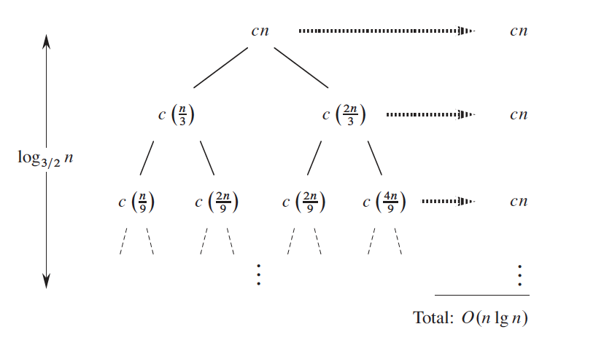
Example of recursion tree
T(n) = T(n/3) + T(2n/3) + n

Slide 44
Example of recursion tree
T(n) = T(n/3) + T(2n/3) + n

Slide 45
Example of recursion tree
T(n) = T(n/3) + T(2n/3) + n

Slide 46
Example of recursion tree
T(n) = T(n/3) + T(2n/3) + n

Slide 47
Example of recursion tree
T(n) = T(n/3) + T(2n/3) + n

Slide 48
Example 5

Slide 49
Example of recursion tree
Solve T(n) = T(n/4) + T(n/2) + n²:

Slide 50
Example of recursion tree
Solve T(n) = T(n/4) + T(n/2) + n²:
T(n)

Slide 51
Example of recursion tree
Solve T(n) = T(n/4) + T(n/2) + n²:
n²
T(n/4)
T(n/2)

Slide 52
Example of recursion tree
Solve T(n) = T(n/4) + T(n/2) + n²:
n²
(n/4)²
(n/2)²
T(n/16)
T(n/8)
T(n/8)
T(n/4)

Slide 53
Example of recursion tree
Solve T(n) = T(n/4) + T(n/2) + n²:
n²
(n/4)²
(n/2)²
(n/16)²
(n/8)²
(n/8)²
(n/4)²
…
Θ(1)

Slide 54
Example of recursion tree
Solve T(n) = T(n/4) + T(n/2) + n²:
n²
(n/4)²
(n/2)²
(n/16)²
(n/8)²
(n/8)²
(n/4)²
…
Θ(1)

Slide 55
Example of recursion tree
Solve T(n) = T(n/4) + T(n/2) + n²:
n²
(n/4)²
(n/2)²
(n/16)²
(n/8)²
(n/8)²
(n/4)²
…
Θ(1)

Slide 56
Example of recursion tree
Solve T(n) = T(n/4) + T(n/2) + n²:
n²
(n/4)²
(n/2)²
(n/16)²
(n/8)²
(n/8)²
(n/4)²
…
…
Θ(1)

Slide 57
Example of recursion tree
Solve T(n) = T(n/4) + T(n/2) + n²:
n²
(n/4)²
(n/2)²
(n/16)²
(n/8)²
(n/8)²
(n/4)²
…
…
Θ(1)
Total =

Slide 58
Appendix: geometric series
for x ≠ 1
for |x| < 1
X = (5/16)

Slide 59
Example of recursion tree
Solve T(n) = T(n/4) + T(n/2) + n²:
n²
(n/4)²
(n/2)²
(n/16)²
(n/8)²
(n/8)²
(n/4)²
…
…
Θ(1)
Total =
= 1.45n²
Θ(n²)

Slide 60
Example 6

Slide 61
Example of recursion tree
Solve T(n) = 3T(n/4) + cn²

Slide 62
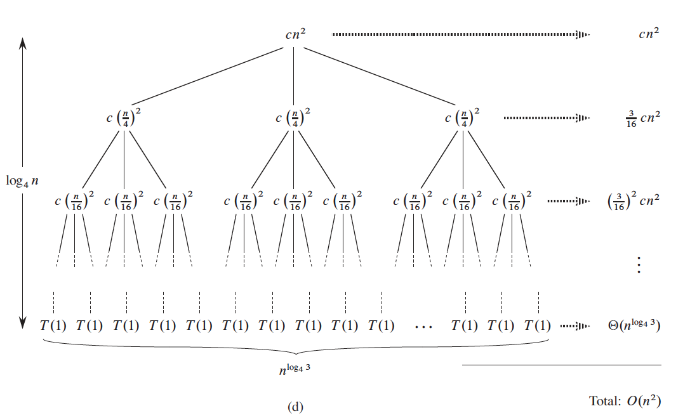
Example of recursion tree
Solve T(n) = 3T(n/4) + cn²

Slide 63
Example of recursion tree
Solve T(n) = 3T(n/4) + cn²

Slide 64
Example of recursion tree
Solve T(n) = 3T(n/4) + cn²

Slide 65
Example of recursion tree
Solve T(n) = 3T(n/4) + cn²

Slide 66
Appendix: geometric series
for x ≠ 1
for |x| < 1
X = (3/16)

Slide 67

Example of recursion tree
Solve T(n) = 3T(n/4) + cn²
= 1.23n² +

Slide 68
Your Turn

Slide 69
Solve T(n) = 7T(n/2) + cn

Slide 70

T(n) = 7T(n/2) + cn

Slide 71
Solve T(n) = 2T(n/3) + cn²

Slide 72
T(n) = 2T(n/3) + n²
T(n) = O(n²)

Slide 73
Solve T(n) = 8T(n/2) + cn³

Slide 74
T(n) = 8T(n/2) + n³
T(n) = O(n³logn)

